Slide 2
Seminole County Teach-In 2017
The Importance of GitHub to Your Software Professional Career
Ed Burns
Consulting Member of Technical Staff
Java EE Standards and Cloud Technologies
November, 2017
Notes:
This is a Title Slide with Picture slide ideal for including a picture with a brief title, subtitle and presenter information.
To customize this slide with your own picture:
Right-click the slide area and choose Format Background from the pop-up menu. From the Fill menu, click Picture and texture fill. Under Insert from: click File. Locate your new picture and click Insert.
To copy the Customized Background from Another Presentation on PC
Click New Slide from the Home tab's Slides group and select Reuse Slides.
Click Browse in the Reuse Slides panel and select Browse Files. Double-click the PowerPoint presentation that contains the background you wish to copy.
Check Keep Source Formatting and click the slide that contains the background you want.
Click the left-hand slide preview to which you wish to apply the new master layout.
Apply New Layout (Important): Right-click any selected slide, point to Layout, and click the slide containing the desired layout from the layout gallery.
Delete any unwanted slides or duplicates.
To copy the Customized Background from Another Presentation on Mac
Click New Slide from the Home tab's Slides group and select Insert Slides from Other Presentation…
Navigate to the PowerPoint presentation file that contains the background you wish to copy. Double-click or press Insert. This prompts the Slide Finder dialogue box.
Make sure Keep design of original slides is unchecked and click the slide(s) that contains the background you want. Hold Shift key to select multiple slides.
Click the left-hand slide preview to which you wish to apply the new master layout.
Apply New Layout (Important): Click Layout from the Home tab's Slides group, and click the slide containing the desired layout from the layout gallery.
Delete any unwanted slides or duplicates.

Slide 3
Notes:
This is a Safe Harbor Front slide, one of two Safe Harbor Statement slides included in this template.
One of the Safe Harbor slides must be used if your presentation covers material affected by Oracle’s Revenue Recognition Policy
To learn more about this policy, e-mail: Revrec-americasiebc_us@oracle.com
For internal communication, Safe Harbor Statements are not required. However, there is an applicable disclaimer (Exhibit E) that should be used, found in the Oracle Revenue Recognition Policy for Future Product Communications. Copy and paste this link into a web browser, to find out more information.
http://my.oracle.com/site/fin/gfo/GlobalProcesses/RevRec/Policies/cnt2321729.pdf
For all external communications such as press release, roadmaps, PowerPoint presentations, Safe Harbor Statements are required. You can refer to the link mentioned above to find out additional information/disclaimers required depending on your audience.

Slide 4
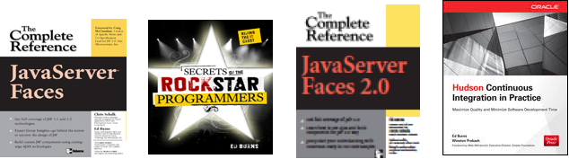
Speaker Qualifications
Worked on the world’s first graphical web browser, NCSA Mosaic in 1994
Graduated with Bachelor of Science in CS from University of Illinois in Urbana-Champaign in 1995
Joined Sun Microsystems in 1997, at the beginning of Java
Joined Oracle in 2010, through its acquisition of Sun
Author of four IT books for McGraw-Hill
Notes:
Give Neil slide 3.

Slide 5
My Plan For Your Time Investment
1
Oracle and K-12 Education
GitHub
Version Control in General and with Git
Version Control With Git
GitHub Extras
2
3
4
5

Slide 6

Oracle and K-12 Education
Subtitle
Notes:
This is a Section Header with Picture slide ideal for including a picture with a brief title and optional subtitle. This slide can also be used as a Q and A slide.
To customize this slide with your own picture:
Right-click the slide area and choose Format Background from the pop-up menu. From the Fill menu, click Picture and texture fill. Under Insert from: click File. Locate your new picture and click Insert.
To copy the Customized Background from Another Presentation on PC
Click New Slide from the Home tab's Slides group and select Reuse Slides.
Click Browse in the Reuse Slides panel and select Browse Files. Double-click the PowerPoint presentation that contains the background you wish to copy.
Check Keep Source Formatting and click the slide that contains the background you want.
Click the left-hand slide preview to which you wish to apply the new master layout.
Apply New Layout (Important): Right-click any selected slide, point to Layout, and click the slide containing the desired layout from the layout gallery.
Delete any unwanted slides or duplicates.
To copy the Customized Background from Another Presentation on Mac
Click New Slide from the Home tab's Slides group and select Insert Slides from Other Presentation…
Navigate to the PowerPoint presentation file that contains the background you wish to copy. Double-click or press Insert. This prompts the Slide Finder dialogue box.
Make sure Keep design of original slides is unchecked and click the slide(s) that contains the background you want. Hold Shift key to select multiple slides.
Click the left-hand slide preview to which you wish to apply the new master layout.
Apply New Layout (Important): Click Layout from the Home tab's Slides group, and click the slide containing the desired layout from the layout gallery.
Delete any unwanted slides or duplicates.

Slide 7
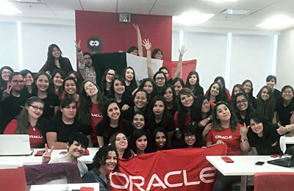
Oracle Academy
Oracle Academy advances computer science education globally to drive knowledge, innovation, skills development, and diversity in technology fields.
Delivers a complete portfolio of computer science learning resources to educational institutions.
https://academy.oracle.com/en/ about-mission.html

Slide 8

Alison Derbenwick Miller VP of Oracle Academy
http://bit.ly/oracle_sxswedu
Three Myths about Computer Science Education
CS is just for rich kids on white collar job paths
Technology is everywhere, so CS education is available to everyone already
You need to be a CS expert to teach it effectively

Slide 9
GitHub
Subtitle
Notes:
This is a Section Header with Picture slide ideal for including a picture with a brief title and optional subtitle. This slide can also be used as a Q and A slide.
To customize this slide with your own picture:
Right-click the slide area and choose Format Background from the pop-up menu. From the Fill menu, click Picture and texture fill. Under Insert from: click File. Locate your new picture and click Insert.
To copy the Customized Background from Another Presentation on PC
Click New Slide from the Home tab's Slides group and select Reuse Slides.
Click Browse in the Reuse Slides panel and select Browse Files. Double-click the PowerPoint presentation that contains the background you wish to copy.
Check Keep Source Formatting and click the slide that contains the background you want.
Click the left-hand slide preview to which you wish to apply the new master layout.
Apply New Layout (Important): Right-click any selected slide, point to Layout, and click the slide containing the desired layout from the layout gallery.
Delete any unwanted slides or duplicates.
To copy the Customized Background from Another Presentation on Mac
Click New Slide from the Home tab's Slides group and select Insert Slides from Other Presentation…
Navigate to the PowerPoint presentation file that contains the background you wish to copy. Double-click or press Insert. This prompts the Slide Finder dialogue box.
Make sure Keep design of original slides is unchecked and click the slide(s) that contains the background you want. Hold Shift key to select multiple slides.
Click the left-hand slide preview to which you wish to apply the new master layout.
Apply New Layout (Important): Click Layout from the Home tab's Slides group, and click the slide containing the desired layout from the layout gallery.
Delete any unwanted slides or duplicates.

Slide 10

Quick Demo: GitHub and README.md
Safari
View GitHub for this presentation
Fork Repository
Make change and send Pull Request
Firefox
Accept Pull Request
View new README.md

Slide 11
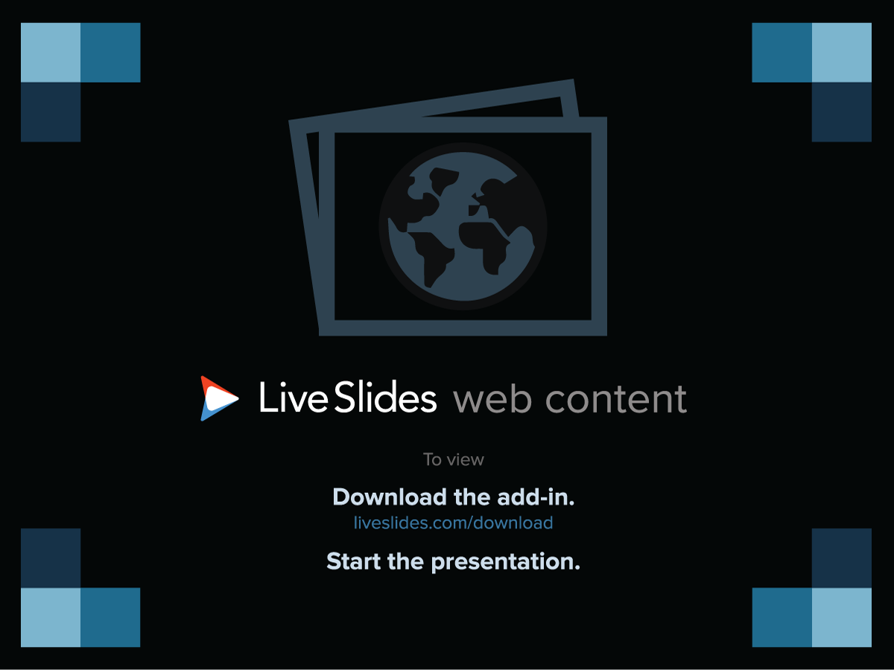
Notes:
LiveSlide Site
https://player.vimeo.com/video/89542305

Slide 12

Introducing GitHub
Took Open Source Software to the big time, starting in 2008
What is Open Source Software?
S
Notes:
Welcome to try samples there

Slide 13
Notes:
LiveSlide Site
https://www.youtube.com/watch?v=9sJUDx7iEJw&t=21

Slide 14
Notes:
LiveSlide Site
https://www.youtube.com/watch?v=kCpjg50-nvc

Slide 15
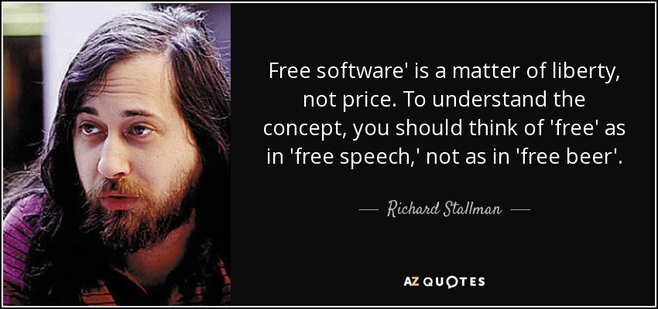
First Came Free Software

Slide 16

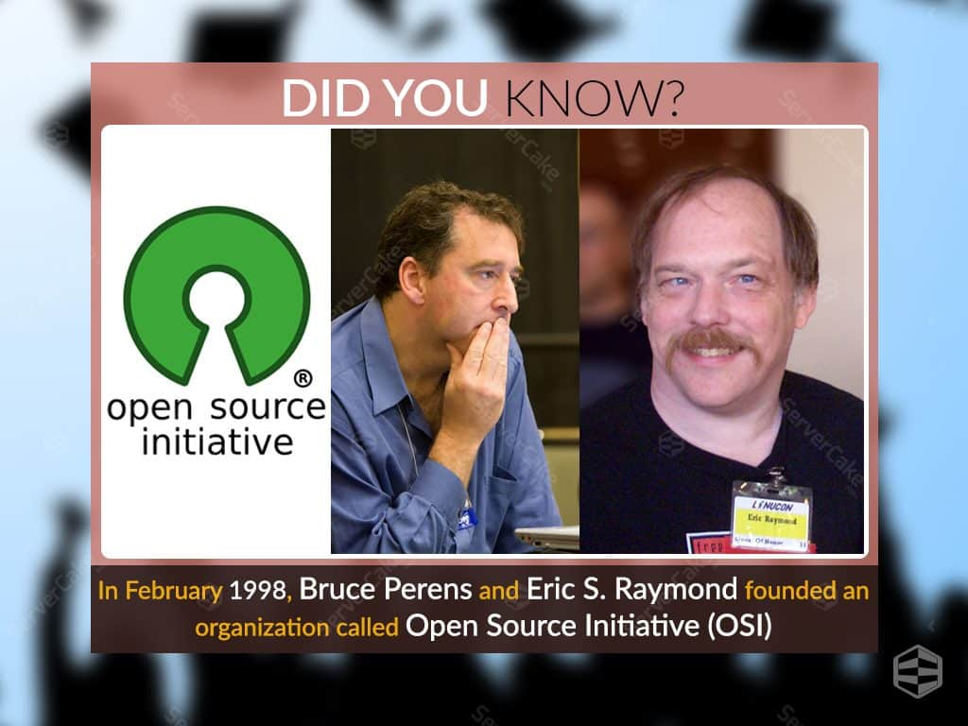



Then Came Open Source Software

Slide 17
What is the Difference?
The difference is a matter of liberty and legality
Both give everyone access to the source code
Free Software
grants everyone the right to freely modify, enhance, and the obligation to share those enhancements with everyone
Open Source Software
does not require any sort of legal freedom
Yes, you can see the source code
But you may not be able to do anything with it
Open Source Software can also be Free Software, but the converse is usually not true

Slide 18

Life Before Open Source
Notes:
Proprietary programming languages
Proprietary software
Skills not portable from job to job
Difficult to build a “portfolio” of work

Slide 19

Life After Open Source
Your portfolio is out there for all to see
You can take your code with you to your next job, if you want
You can build a name for yourself outside of your company

Slide 20


Back To GitHub
S
Notes:
Welcome to try samples there

Slide 21


Slide 22
GitHub
Coins the term ”Social Coding”
Still other players exist
GitLab
BitBucket

Slide 23

Git
Subtitle
Notes:
This is a Section Header with Picture slide ideal for including a picture with a brief title and optional subtitle. This slide can also be used as a Q and A slide.
To customize this slide with your own picture:
Right-click the slide area and choose Format Background from the pop-up menu. From the Fill menu, click Picture and texture fill. Under Insert from: click File. Locate your new picture and click Insert.
To copy the Customized Background from Another Presentation on PC
Click New Slide from the Home tab's Slides group and select Reuse Slides.
Click Browse in the Reuse Slides panel and select Browse Files. Double-click the PowerPoint presentation that contains the background you wish to copy.
Check Keep Source Formatting and click the slide that contains the background you want.
Click the left-hand slide preview to which you wish to apply the new master layout.
Apply New Layout (Important): Right-click any selected slide, point to Layout, and click the slide containing the desired layout from the layout gallery.
Delete any unwanted slides or duplicates.
To copy the Customized Background from Another Presentation on Mac
Click New Slide from the Home tab's Slides group and select Insert Slides from Other Presentation…
Navigate to the PowerPoint presentation file that contains the background you wish to copy. Double-click or press Insert. This prompts the Slide Finder dialogue box.
Make sure Keep design of original slides is unchecked and click the slide(s) that contains the background you want. Hold Shift key to select multiple slides.
Click the left-hand slide preview to which you wish to apply the new master layout.
Apply New Layout (Important): Click Layout from the Home tab's Slides group, and click the slide containing the desired layout from the layout gallery.
Delete any unwanted slides or duplicates.

Slide 24



GitHub is packaging around Git
Lots of other goodies as well, but git is the heart of it

Slide 25
What is an SCM
SCM stands for Source Code Management
Checkin: organized common access to sources
History: who did commit which code at what time. This creates the full history of all the source code.
Versioning: reconstruct an exact original state at a later time
Slide content from Mark Struberg, Apache Software Foundation

Slide 26
What is an SCM (cntd)
Branches: Maintaining multiple versions of the sources. E.g. feature branches and maintainance branches
Tagging: 'freeze' a state and give it a special 'name'
Comments: each change can have a comment which describes the reason for the change.
Annotations: who change which line in a file?
Slide content from Mark Struberg, Apache Software Foundation

Slide 27
general SCM categories
there are a few typical features which distinguish various SCMs:
Daemon based SCMs vs File based
Distributed SCMs without a technical 'master' system vs Client-Server systems.
file locking vs conflict merging
Slide content from Mark Struberg, Apache Software Foundation

Slide 28
Overview different SCM systems
CVS
SVN
SourceSafe
Mercurial
BitKeeper
Slide content from Mark Struberg, Apache Software Foundation

Slide 29
SCM Comparison: GIT
GIT works similar to patch based systems
GIT is de-centralised: all changes are also available 'offline'
All 'patches' are available locally
Commits are cryptographically strong
Slide content from Mark Struberg, Apache Software Foundation

Slide 30
The basic GIT idea
Slide content from Mark Struberg, Apache Software Foundation

Slide 31
GIT Concepts: Object tree
GIT always tracks the whole repository
GIT tracks a tree containing diffs with their 'parents' and commit Information
.git/objects contains all those commits
each commit has a unique sha1 containing the diff-object plus tree information, and further
each commit has a unique sha1 containing the tree-object + commit info
git 'packs' objects space optimized.
Slide content from Mark Struberg, Apache Software Foundation

Slide 32
GIT Concepts: Commit Information
Distinguishing between Author and Committer
commit text
author and commit date
Slide content from Mark Struberg, Apache Software Foundation

Slide 33
GIT Concepts: the 'Index'
GIT doesn't work directly against the Repository but has a 'preparation area' called 'Index'
all changes prepared in that 'Index' will only get stored to the Repositories tree-objects with the 'commit'
upstream repo1
I N D E X
local repo
file change
upstream repo2
Slide content from Mark Struberg, Apache Software Foundation

Slide 34
Some GIT history
Junio C. Hamano is the maintainer of GIT since almost the beginning.
GIT is 'Distributed', a new generation of SCMs. It requires a different mind-set in comparison to Client-Server based systems.
Linus Torvalds developed GIT in April 2005, after lots of discussions regarding BitKeeper to maintain the Linux kernel
Slide content from Mark Struberg, Apache Software Foundation

Slide 35
Topology of classical SCMs
Client-Server Architecture
All use the same Repository
Each committer has write access
Each committer checks in his changes himself – there is no review before checkin.
SCM
Slide content from Mark Struberg, Apache Software Foundation

Slide 36
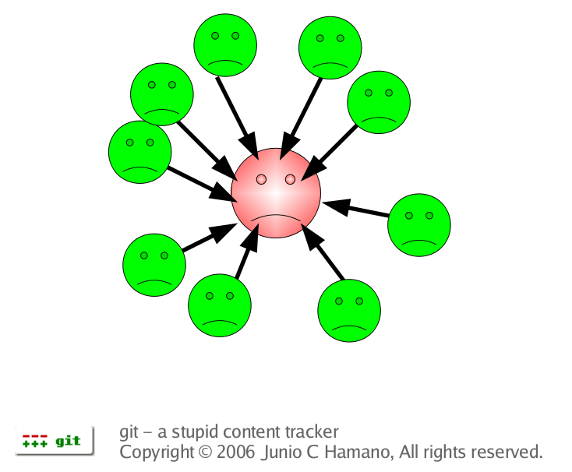
Linux kernel maintenance - old style
Linus as single "Committer"
All people sending patches to Linus
Linus merged all Patches
Linus maintained all changes himself
Slide content from Mark Struberg, Apache Software Foundation

Slide 37
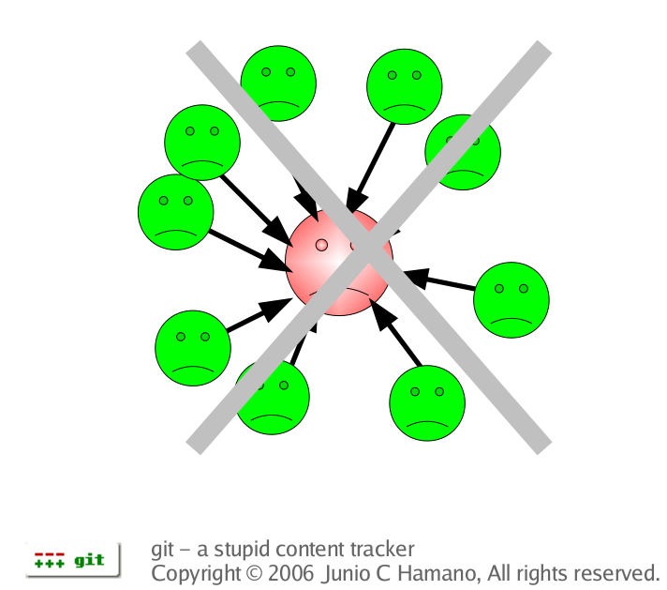
Problems of classical SCMs
Classical Client-Server SCMs require a strict hierarchical organisation.
Only works if the server is up and running
Working offline is impossible
In bigger projects you often face problems with access control
Slide content from Mark Struberg, Apache Software Foundation

Slide 38
Topology of DSCMs
Mathias
Susanne
Stephan
Mark
Sigi
Slide content from Mark Struberg, Apache Software Foundation

Slide 39
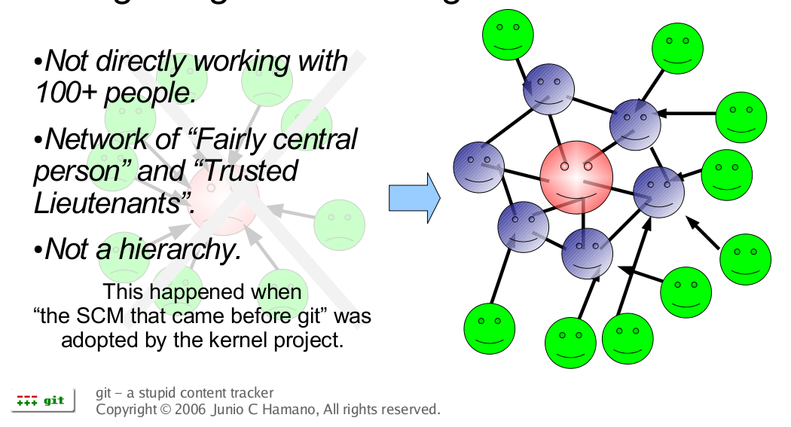
Maintaining Linux with Git
Slide content from Mark Struberg, Apache Software Foundation

Slide 40
Network of Trust
Each user only writes to his own Repository
Which means no authorisation problem
Good changes get pulled actively
Author of a change remains in the commit
There is no technical master system
Self organisation based on Quality
Changes get reviewed a few times
Slide content from Mark Struberg, Apache Software Foundation

Slide 41
Git Repository
Pure content-tracking (NO file-tracking)
list of changes (diffs)
GIT collects Changes within a tree
Direct Acyclic dependent Graph (DAG) of changes
Each change has a unique SHA1 hash
That implies Security
Additional GPG signature possible for tags
submodules support
all info under .git - no garbage in your work tree
supports various transmission protocols
Slide content from Mark Struberg, Apache Software Foundation

Slide 42
Weak spots of GIT
optimized for whole trees and not for single files
Annotation is pretty expensive
GIT manages no authorisation
GIT manages no file metadata
Slide content from Mark Struberg, Apache Software Foundation

Slide 43

GitHub Extras

Slide 44
GitHub Extras
The Commit Strip
Gist
Issues
GitHub Pages
https://education.github.com/

Slide 45
Commit Strip
Shows your public commits
A visual gauge of how active you are in open source
Increases in value as GitHub itself becomes more pervasive

Slide 46
Gist
For quick sharing of code
Permanent link
Line numbers
Comments

Slide 47
Issues
SUPER IMPORTANT professionally
How you get work assigned to you
How your productivity may be measured by your employer
Has features for planning your time

Slide 48
GitHub Pages
Free web hosting (DNS not included)
http://ridingthecrest.com/
http://battleofthesomme.info/
https://guides.github.com/features/pages/

Slide 49

GitHub Student Pack
https://education.github.com/pack

Slide 50
Notes:
This is a Safe Harbor Front slide, one of two Safe Harbor Statement slides included in this template.
One of the Safe Harbor slides must be used if your presentation covers material affected by Oracle’s Revenue Recognition Policy
To learn more about this policy, e-mail: Revrec-americasiebc_us@oracle.com
For internal communication, Safe Harbor Statements are not required. However, there is an applicable disclaimer (Exhibit E) that should be used, found in the Oracle Revenue Recognition Policy for Future Product Communications. Copy and paste this link into a web browser, to find out more information.
http://my.oracle.com/site/fin/gfo/GlobalProcesses/RevRec/Policies/cnt2321729.pdf
For all external communications such as press release, roadmaps, PowerPoint presentations, Safe Harbor Statements are required. You can refer to the link mentioned above to find out additional information/disclaimers required depending on your audience.

